Slide 1
CSCE 689: Special Topics in Modern Algorithms for Data Science
Lecture 1
Samson Zhou

Slide 2

Why Data Science?
Notes:
Enough about me, let’s talk about data science. Sources of big data are now universally present, across social media, financial markets, Internet of things, scientific data, so on and so forth, and thus understanding how to effectively and efficiently summarize the data is a crucial step toward both understanding past events as well as predicting future events.

Slide 3
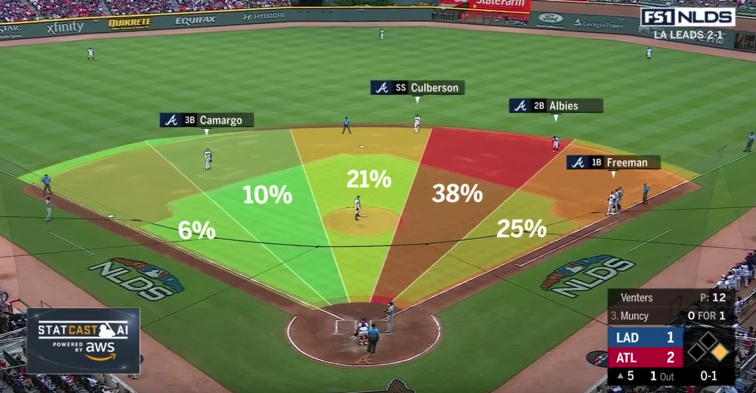

Slide 4
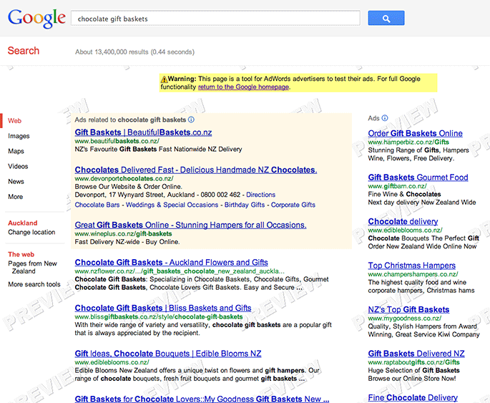

Slide 5
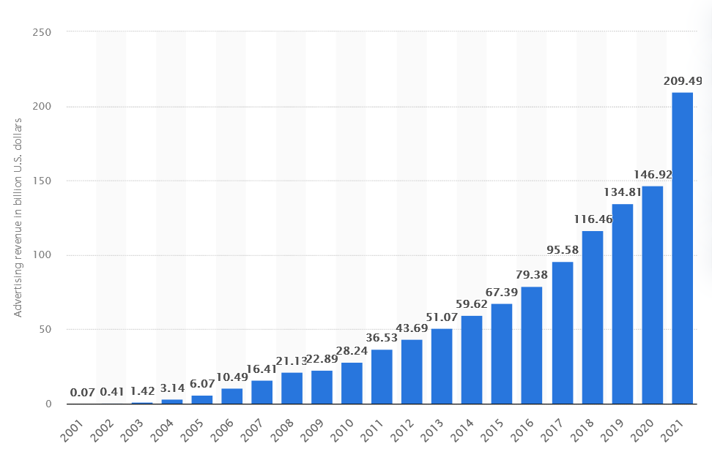

Google Ad Revenue (2001-2021, billion USD)

Slide 6
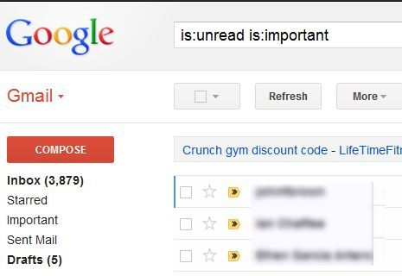
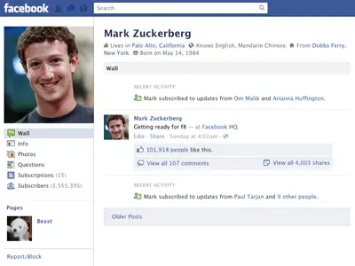

330 billion daily e-mails
3 billion monthly active users
8.5 billion daily Google searches

Slide 7
How do these companies process the information to target advertisements? To predict trends? To improve their products?
330 billion daily e-mails
3 billion monthly active users
8.5 billion daily Google searches

Slide 8
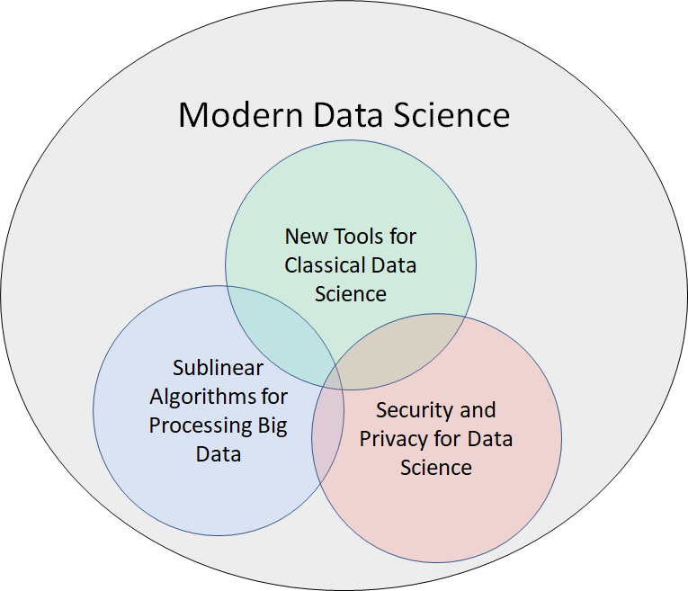
Evolving Demands
Sublinear-time or sublinear-space algorithms
Incorporation of advice
Security and privacy
Robustness to noise or adversarial input
Ability to handle time-sensitive data
Notes:
However, as the field of big data algorithms matures, we have realized that often implementing an algorithm to simply perform analysis is not enough; we might also require specific properties or functionality from the algorithm, such as sublinear-time or sublinear-space, incorporation of advice, security and privacy, robustness to noise or adversarial input, or the ability to handle time-sensitive data. These are crucial qualities that I’ve integrated into my research on algorithmic design and so throughout this talk as I summarize some of my broader work in each of the Venn diagram categories, I’ll also interleave discussion of these modern demands.

Slide 9
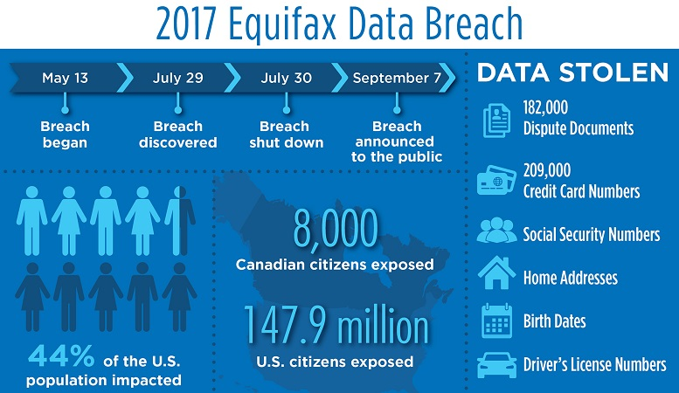
“Equifax agreed to a $700 million settlement over the privacy breach, but $425 million of that was set aside to repay consumers as a restitution fund.”
Notes:
Credit bureau company, delete $125?
Equifax Inc. is an American multinational consumer credit reporting agency headquartered in Atlanta, Georgia and is one of the three largest consumer credit reporting agencies, along with Experian and TransUnion (together known as the "Big Three"). With over 14,000 employees worldwide, Equifax has nearly US$5 billion in annual revenue and is traded on the New York Stock Exchange (NYSE) under the symbol EFX

Slide 10















Slide 11

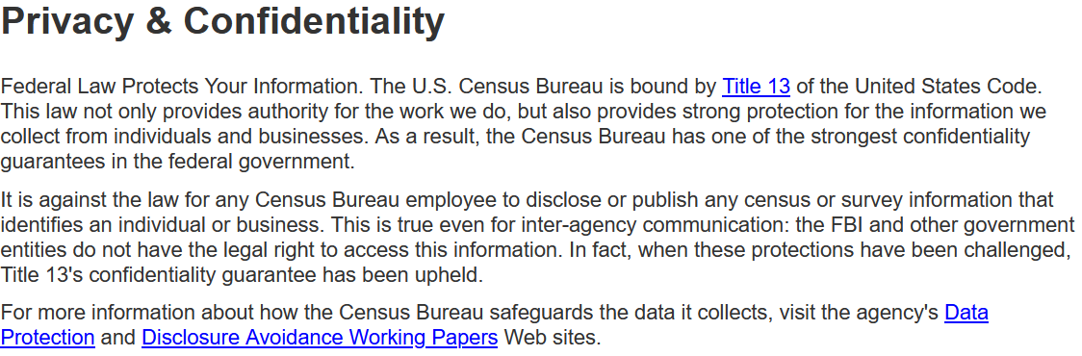
census.gov:

Slide 12
Anonymizing Data
Age | Zip Code | Employer | Has Pet
56 | 77005 | Apple | Yes
32 | 77005 | Microsoft | No
71 | 77005 | Amazon | Yes
44 | 77005 | Petsmart | Yes
25 | 77005 | Netflix | No
61 | 77005 | Google | No

Slide 13
Anonymizing Data
Age | Zip Code | Employer | Has Pet
56 | 77005 | Apple | Yes
32 | 77005 | Microsoft | No
71 | 77005 | Amazon | Yes
44 | 77005 | Petsmart | Yes
25 | 77005 | Netflix | No
61 | 77005 | Google | No
Name | Age | Gender | Employer
Alice | 56 | Female | Apple
Bob | 32 | Male | Microsoft
Carol | 71 | Female | Amazon
Dale | 44 | Male | Petsmart
Erin | 25 | Female | Netflix
Fred | 61 | Male | Google

Slide 14
Reconstruction Attack
Name | Age | Zip Code | Gender | Employer | Has Pet
Alice | 56 | 77005 | Female | Apple | Yes
Bob | 32 | 77005 | Male | Microsoft | No
Carol | 71 | 77005 | Female | Amazon | Yes
Dale | 44 | 77005 | Male | Petsmart | Yes
Erin | 25 | 77005 | Female | Netflix | No
Fred | 61 | 77005 | Male | Google | No

Slide 15
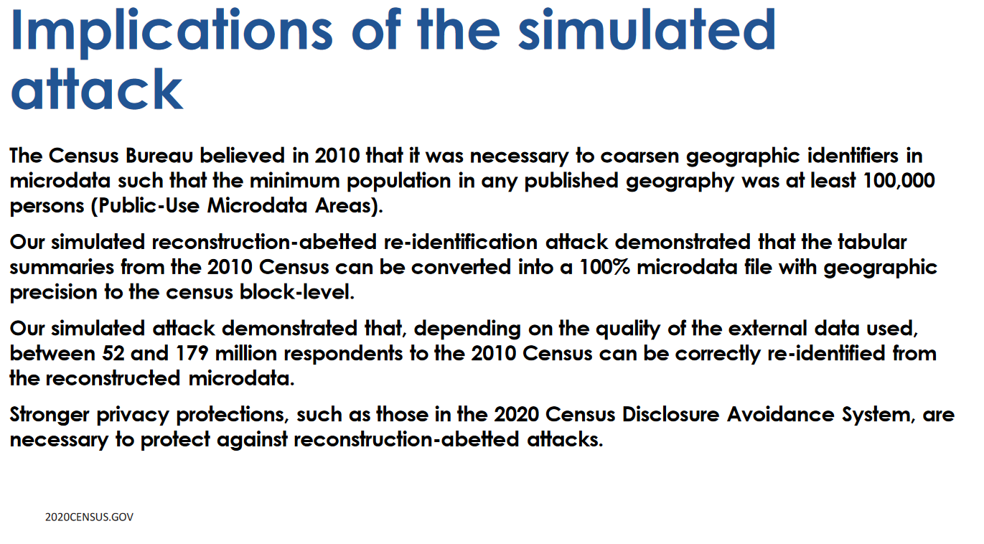

Slide 16
Class Motivation
Data Science is highly interdisciplinary and highly evolving
Many techniques are not covered in traditional CS classes

Slide 17
Modern Algorithms for Data Science
Algorithms for data science
Sublinear algorithms
Models of computation for big data
Differential privacy

Slide 18
Logistics
HRBB 126, MWF, 1:50-2:40 pm CT
Office Hours: PETR 424, 3 pm CT on Wednesdays
Course materials: https://samsonzhou.github.io/csce689-2023

Slide 19
Primary Goals
Describe the motivation and statement of central data science problems, measured by the midterm presentation
Work in various big data models of computation, leading toward the final project
Understand the fundamentals of private data analysis
Demonstrate awareness of common algorithmic techniques, through scribe notes

Slide 20
Secondary Goals
Describe the motivation and statement of central data science problems, measured by the midterm presentation (practice reading and presenting technical papers)
Work in various big data models of computation, leading toward the final project (practice thinking about research!)
Understand the fundamentals of private data analysis
Demonstrate awareness of common algorithmic techniques, through scribe notes (familiarity with LaTeX)

Slide 21
Grading
LaTeX summary of lectures 20%
Midterm presentation 35%
Final project 45%

Slide 22
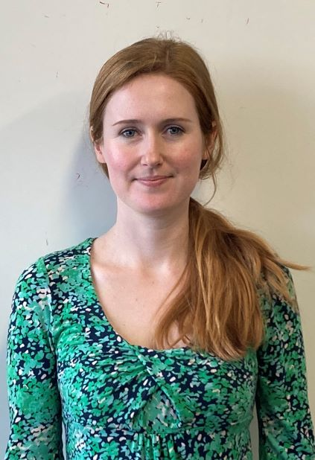
Related Coursework
CSCE 689: Special Topics on Algorithms for Big Data
Taught by Professor Crawford
MWF 10:20-11:00 am, HRBB 126
Topics:
Streaming algorithms
Parallel algorithms
Sublinear time algorithms
Sketching algorithms

Slide 23
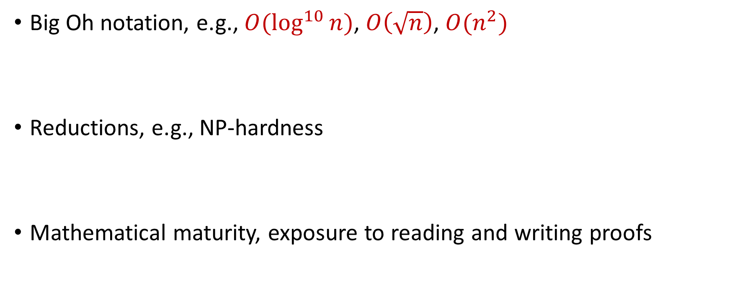
Useful Background
Big Oh notation, e.g., $O(\log^{10}{n)}$, $O\left(\sqrt{n}\right)$, $O(n^{2})$
Reductions, e.g., NP-hardness
Mathematical maturity, exposure to reading and writing proofs

Slide 24
Questions?

Slide 25
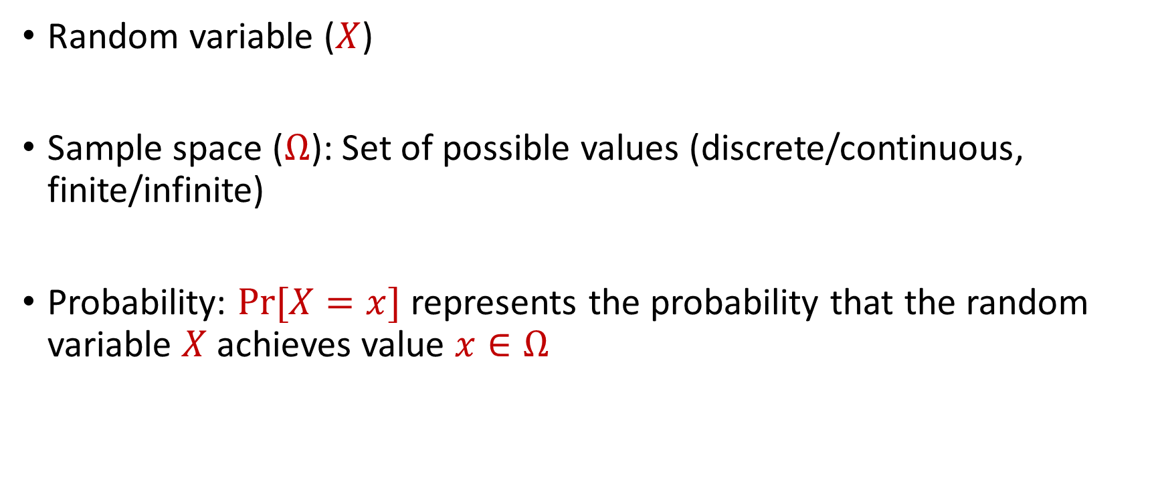
Probability Basics
Random variable ($X$)
Sample space ($Ω$): Set of possible values (discrete/continuous, finite/infinite)
Probability: $Pr[X=x]$ represents the probability that the random variable $X$ achieves value $x∈Ω$

Slide 26
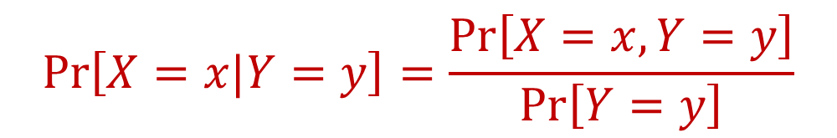
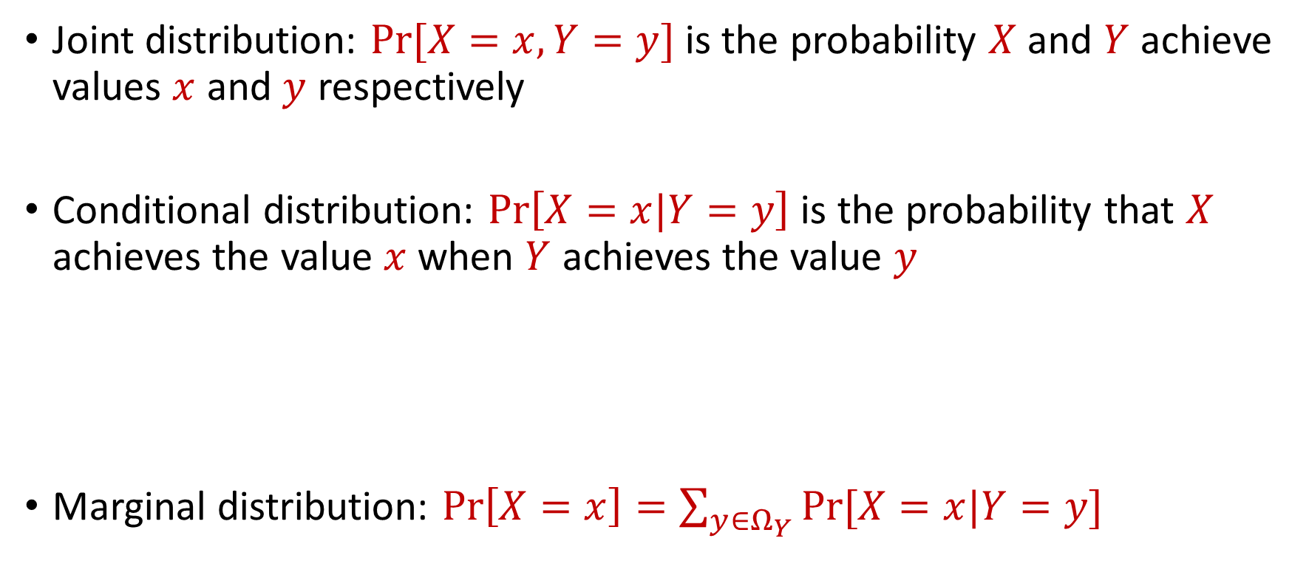
Joint and Conditional Probability
Joint distribution: $Pr[X=x, Y=y]$ is the probability $X$ and $Y$ achieve values $x$ and $y$ respectively
Conditional distribution: $Pr\left[X=x|Y=y\right]$ is the probability that $X$ achieves the value $x$when $Y$ achieves the value $y$
Marginal distribution: $Pr\left[X=x\right]=\sum_{y∈Ω_{Y}}{Pr[X=x|Y=y]}$
$$Pr\left[X=x|Y=y\right]=\frac{Pr\left[X=x, Y=y\right]}{Pr\left[Y=y\right]}$$

Slide 27

Independence
Random variables $X$ and $Y$ are independent if $Pr\left[X=x\right]=Pr\left[X=x|Y=y\right]$ for all possible outcomes $x∈Ω_{X}$, $y∈Ω_{Y}$

Slide 28

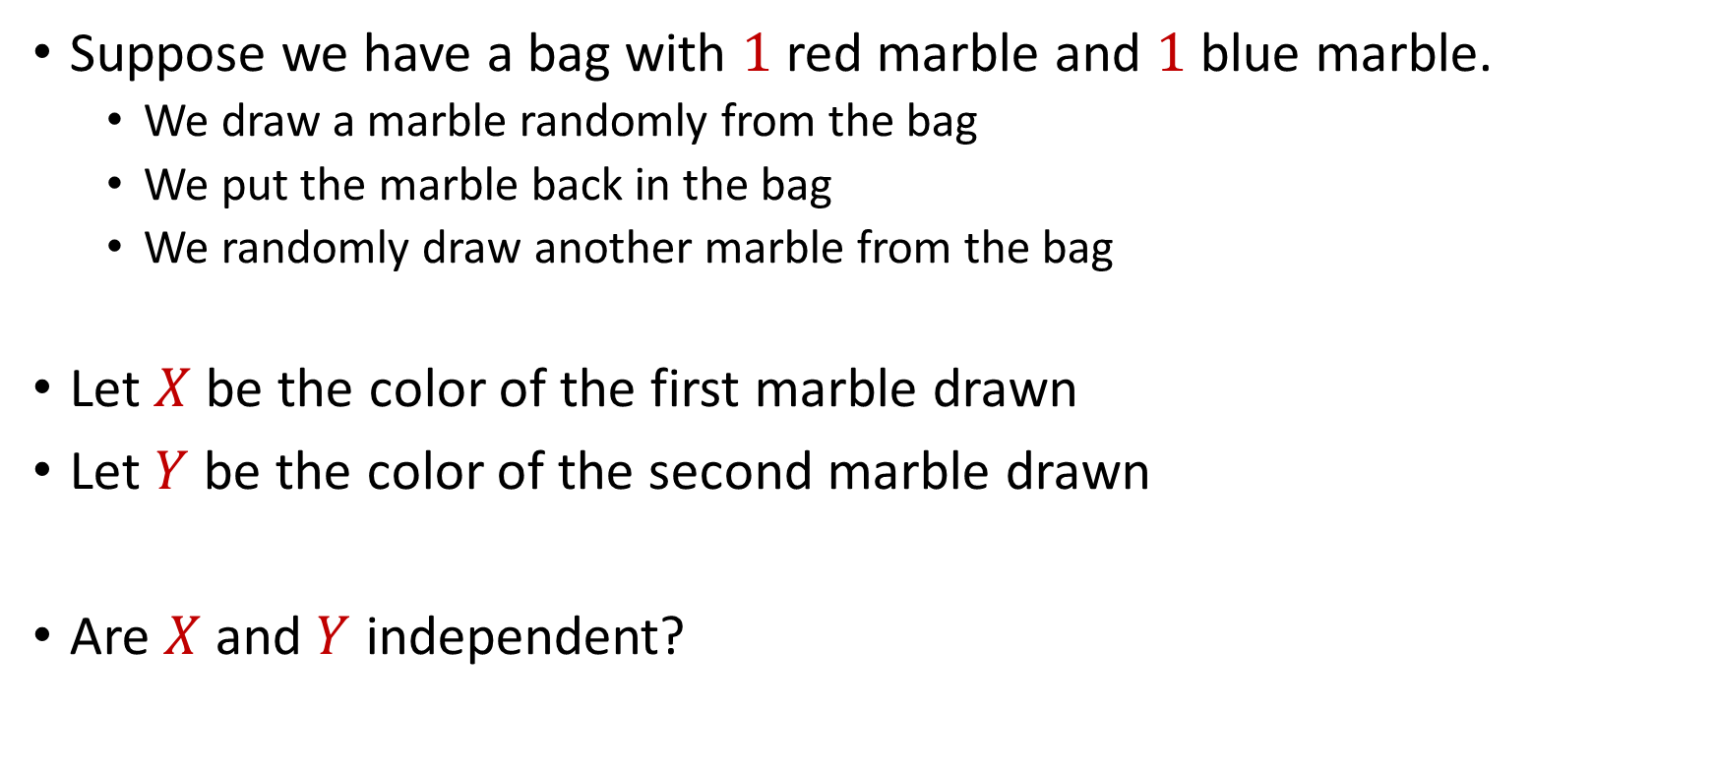
Independence
Suppose we have a bag with $1$ red marble and $1$ blue marble.
We draw a marble randomly from the bag
We put the marble back in the bag
We randomly draw another marble from the bag
Let $X$ be the color of the first marble drawn
Let $Y$ be the color of the second marble drawn
Are $X$ and $Y$ independent?

Slide 29

Independence
Suppose we have a bag with $1$ red marble and $1$ blue marble.
We draw a marble randomly from the bag
We DO NOT put the marble back in the bag
We randomly draw another marble from the bag
Let $X$ be the color of the first marble drawn
Let $Y$ be the color of the second marble drawn
Are $X$ and $Y$ independent?

Slide 30
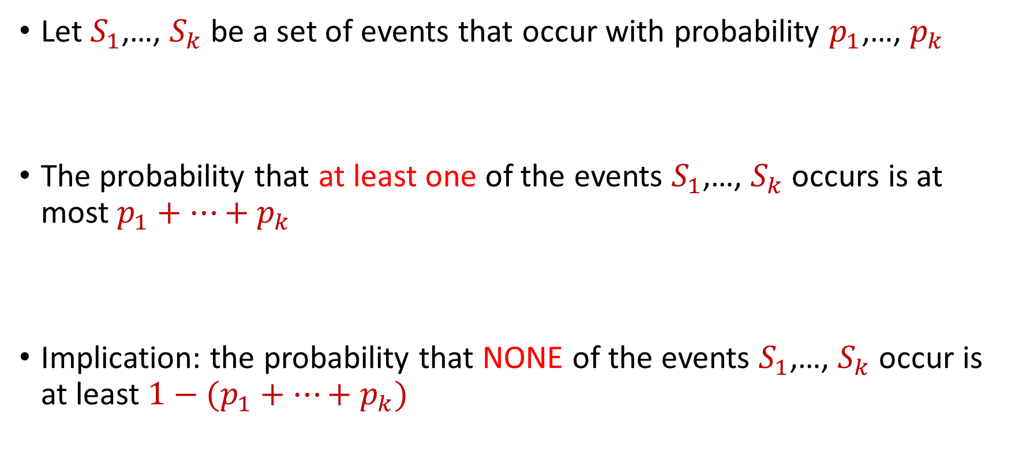
Boole’s Inequality (Union Bound)
Let $S_{1}$,…, $S_{k}$ be a set of events that occur with probability $p_{1}$,…, $p_{k}$
The probability that at least one of the events $S_{1}$,…, $S_{k}$ occurs is at most $p_{1}+…+p_{k}$
Implication: the probability that NONE of the events $S_{1}$,…, $S_{k}$ occur is at least $1−(p_{1}+…+p_{k})$

Slide 31



Boole’s Inequality (Union Bound)
$Pr\left[A∪B\right]=Pr\left[A\right]+Pr\left[B\right]−Pr\left[A∩B\right]$
Proof by induction
$$A$$
$$B$$
$$A∩B$$

Slide 32
CSCE 689: Special Topics in Modern Algorithms for Data Science
Week 1: Probability basics
Samson Zhou

Slide 33
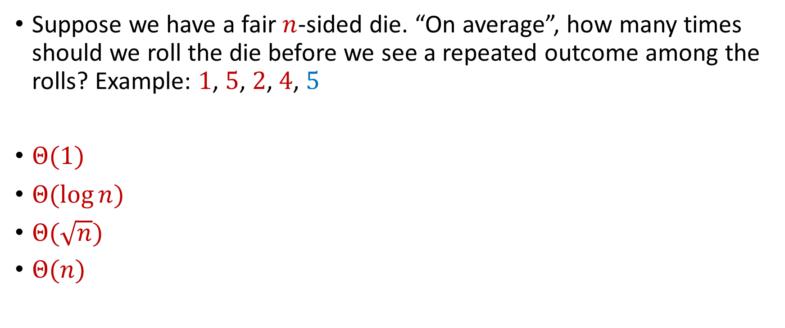
Trivia Question #1 (Birthday Paradox)
Suppose we have a fair $n$-sided die. “On average”, how many times should we roll the die before we see a repeated outcome among the rolls? Example: $1$, $5$, $2$, $4$, $5$
$Θ(1)$
$Θ(\log{n})$
$Θ(\sqrt{n})$
$Θ(n)$

Slide 34

Trivia Question #2 (Limits)
Let $c>0$ be a constant. What is $\lim_{n→∞}{\left(1−\frac{c}{n}\right)}^{n}$?
$0$
$\frac{1}{c}$
$\frac{1}{2c}$
$\frac{1}{e^{c}}$
$1$

Slide 35
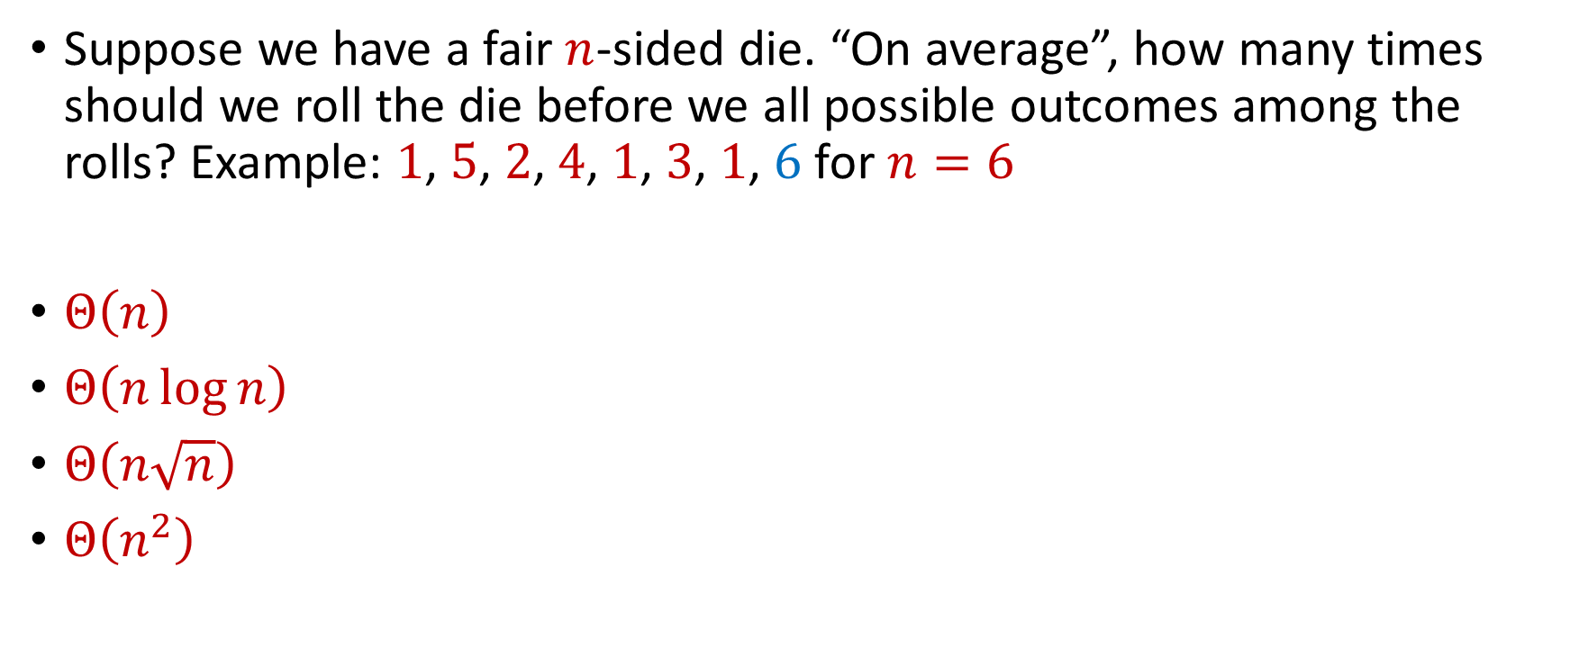
Trivia Question #3 (Coupon Collector)
Suppose we have a fair $n$-sided die. “On average”, how many times should we roll the die before we all possible outcomes among the rolls? Example: $1$, $5$, $2$, $4$, $1$, $3$, $1$, $6$ for $n=6$
$Θ\left(n\right)$
$Θ\left(n\log{n}\right)$
$Θ\left(n\sqrt{n}\right)$
$Θ\left(n^{2}\right)$

Slide 36
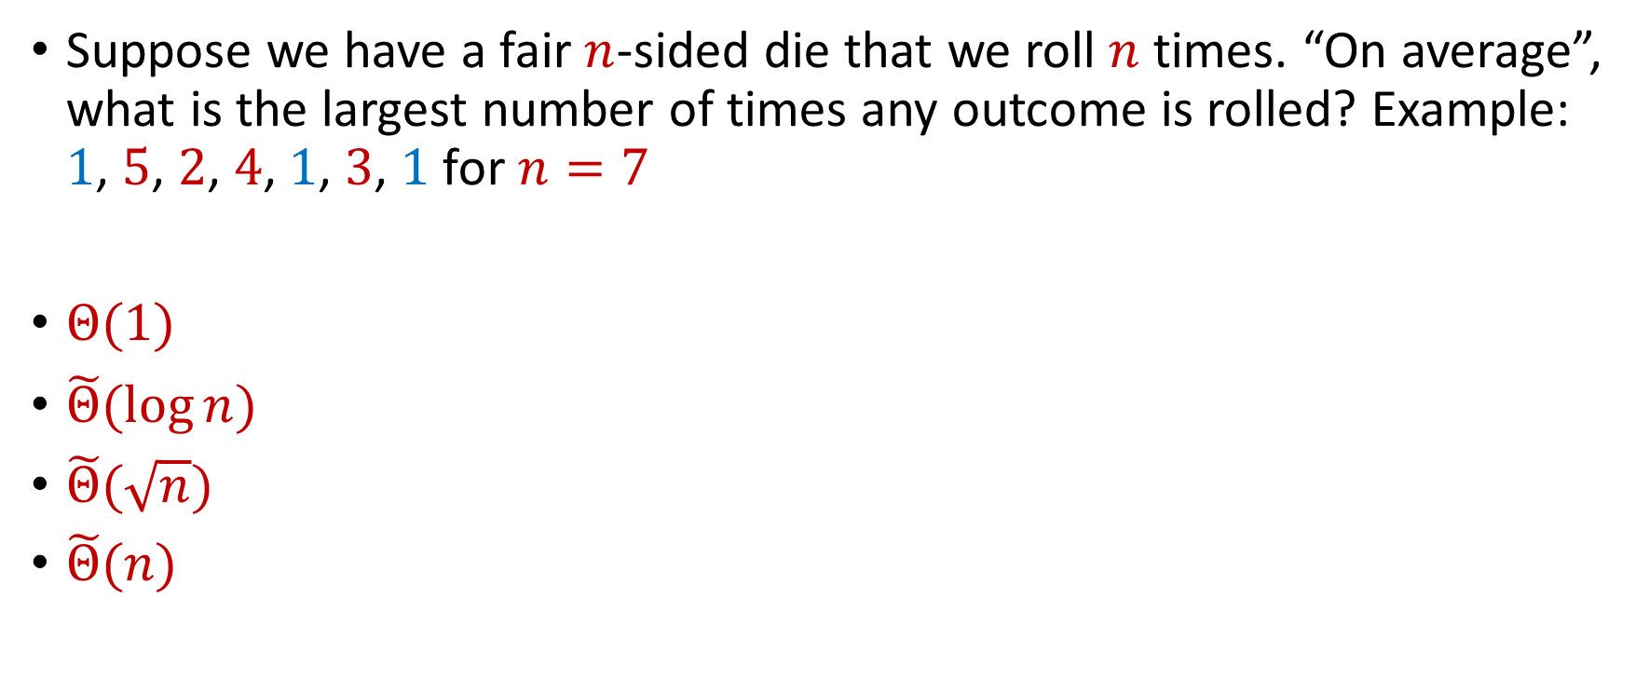
Trivia Question #4 (Max Load)
Suppose we have a fair $n$-sided die that we roll $n$ times. “On average”, what is the largest number of times any outcome is rolled? Example: $1$, $5$, $2$, $4$, $1$, $3$, $1$ for $n=7$
$Θ(1)$
$\tilde{Θ}(\log{n})$
$\tilde{Θ}(\sqrt{n})$
$\tilde{Θ}(n)$

Slide 37

Birthday Paradox
Suppose we have a room with $367$ people. What is the probability that two people share the same birthday?

Slide 38
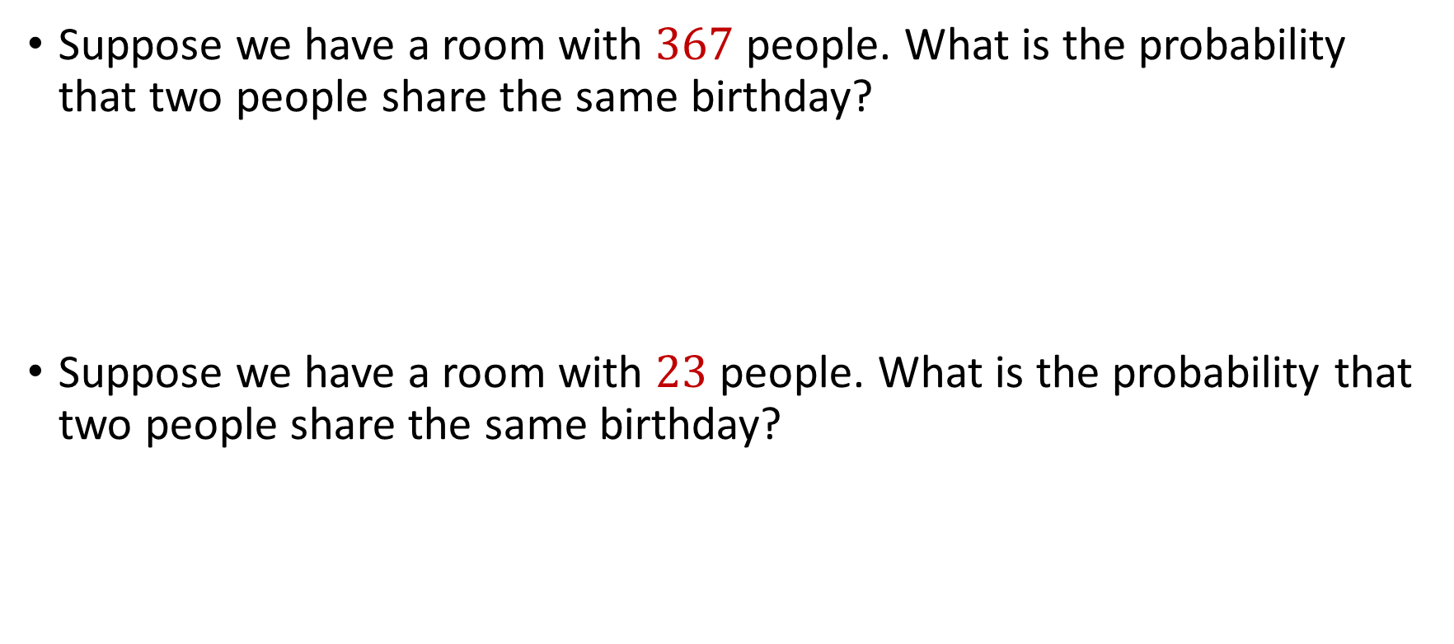
Birthday Paradox
Suppose we have a room with $367$ people. What is the probability that two people share the same birthday?
Suppose we have a room with $23$ people. What is the probability that two people share the same birthday?

Slide 39

Birthday Paradox
Suppose we have a fair $n$-sided die that we roll $k=1\text{,} 2\text{, }3\text{, }4\text{,}\text{...}$ times. What is the probability we see a repeated outcome among the rolls?

Slide 40

Birthday Paradox
Suppose we have a fair $n$-sided die that we roll $k=1\text{,} 2\text{, }3\text{, }4\text{,}\text{...}$ times. What is the probability we see a repeated outcome among the rolls?
$$\left(1−\frac{0}{n}\right)$$

Slide 41

Birthday Paradox
Suppose we have a fair $n$-sided die that we roll $k=1\text{,} 2\text{, }3\text{, }4\text{,}\text{...}$ times. What is the probability we see a repeated outcome among the rolls?
$$\left(1−\frac{0}{n}\right)\left(1−\frac{1}{n}\right)$$

Slide 42
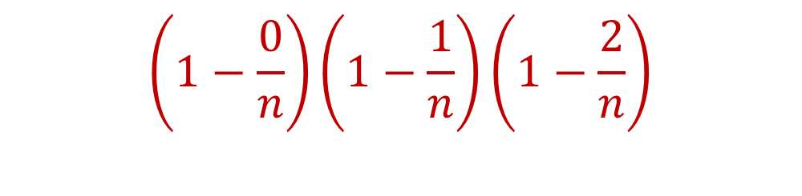
Birthday Paradox
Suppose we have a fair $n$-sided die that we roll $k=1\text{,} 2\text{, }3\text{, }4\text{,}\text{...}$ times. What is the probability we see a repeated outcome among the rolls?
$$\left(1−\frac{0}{n}\right)\left(1−\frac{1}{n}\right)\left(1−\frac{2}{n}\right)$$

Slide 43
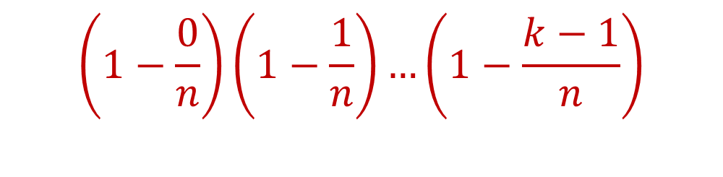
Birthday Paradox
Suppose we have a fair $n$-sided die that we roll $k=1\text{,} 2\text{, }3\text{, }4\text{,}\text{...}$ times. What is the probability we see a repeated outcome among the rolls?
$$\left(1−\frac{0}{n}\right)\left(1−\frac{1}{n}\right)…\left(1−\frac{k−1}{n}\right)$$

Slide 44
Birthday Paradox
Suppose we have a fair $n$-sided die that we roll $k=1\text{,} 2\text{, }3\text{, }4\text{,}\text{...}$ times. What is the probability we see a repeated outcome among the rolls?
$\left(1−\frac{0}{n}\right)\left(1−\frac{1}{n}\right)…\left(1−\frac{k−1}{n}\right)<\frac{1}{2}$ for $k=O(\sqrt{n})$

Slide 45
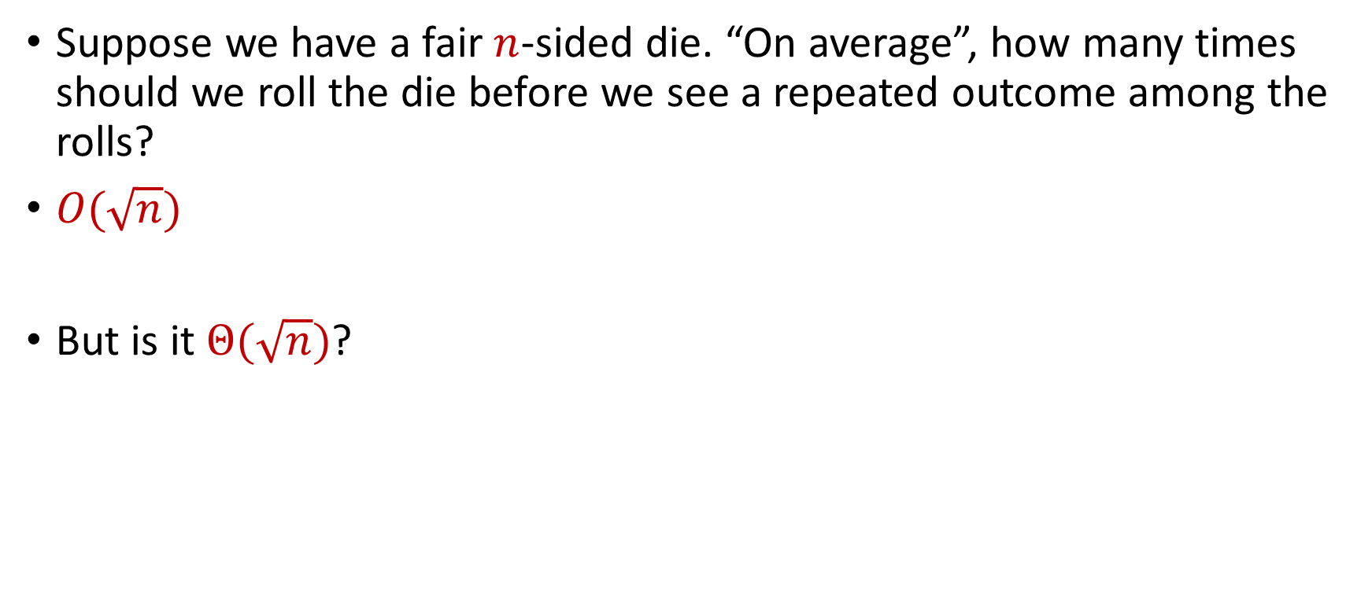
Birthday Paradox
Suppose we have a fair $n$-sided die. “On average”, how many times should we roll the die before we see a repeated outcome among the rolls?
$O(\sqrt{n})$
But is it $Θ(\sqrt{n})$?

Slide 46
Boole’s Inequality (Union Bound)
Let $S_{1}$,…, $S_{k}$ be a set of events that occur with probability $p_{1}$,…, $p_{k}$
The probability that at least one of the events $S_{1}$,…, $S_{k}$ occurs is at most $p_{1}+…+p_{k}$
Implication: the probability that NONE of the events $S_{1}$,…, $S_{k}$ occur is at least $1−(p_{1}+…+p_{k})$

Slide 47
Boole’s Inequality (Union Bound)
$Pr\left[A∪B\right]=Pr\left[A\right]+Pr\left[B\right]−Pr\left[A∩B\right]$
Proof by induction
$$A$$
$$B$$
$$A∩B$$

Slide 48
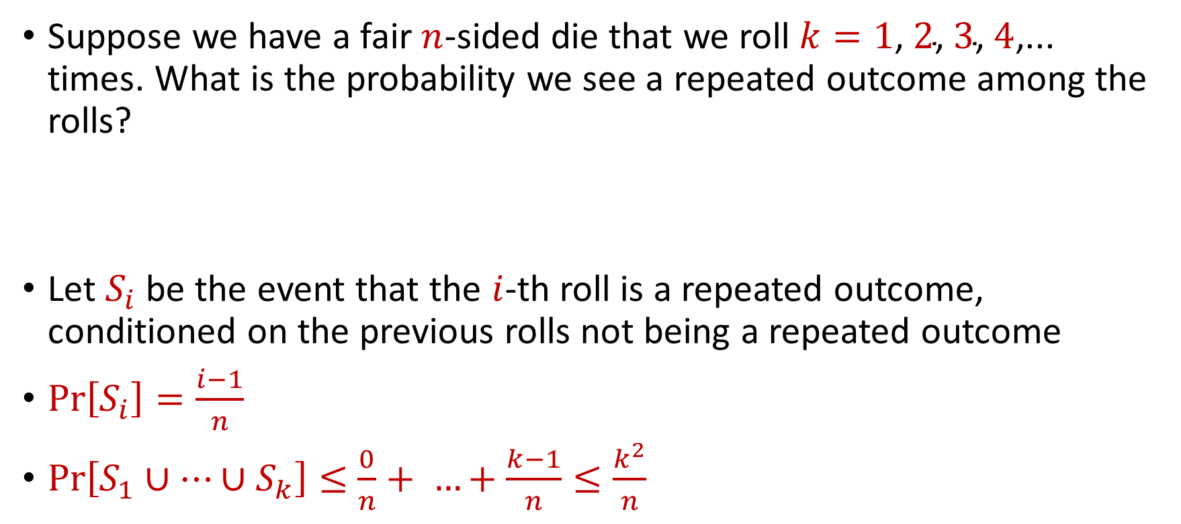
Birthday Paradox
Suppose we have a fair $n$-sided die that we roll $k=1\text{,} 2\text{, }3\text{, }4\text{,}\text{...}$ times. What is the probability we see a repeated outcome among the rolls?
Let $S_{i}$ be the event that the $i$-th roll is a repeated outcome, conditioned on the previous rolls not being a repeated outcome
$Pr\left[S_{i}\right]=\frac{i−1}{n}$
$Pr\left[S_{1}∪…∪S_{k}\right]≤$ $\frac{0}{n}+ …+\frac{k−1}{n}≤\frac{k^{2}}{n}$

Slide 49

Birthday Paradox
Suppose we have a fair $n$-sided die. “On average”, how many times should we roll the die before we see a repeated outcome among the rolls?
$Θ(\sqrt{n})$

Slide 50
Hashing
Suppose we have a data of images, how do we name them consistently?

Slide 51

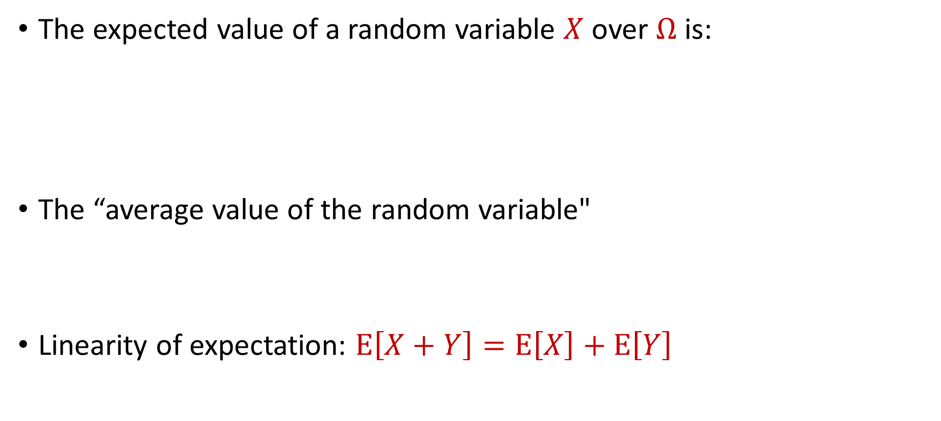
Expected Value
The expected value of a random variable $X$ over $Ω$ is:
The “average value of the random variable"
Linearity of expectation: $E\left[X+Y\right]=E\left[X\right]+E\left[Y\right]$
$$E\left[X\right]=\sum_{x∈Ω}{Pr\left[X=x\right]⋅x}$$

Slide 52

Expected Value
Suppose we roll a $6$-sided die
Let $X$ be the outcome of the roll
What is $E\left[X\right]$?

Slide 53


Moments
For $p>0$, the $p$-th moment of a random variable $X$ over $Ω$ is:
$$E\left[X^{p}\right]=\sum_{x∈Ω}{Pr\left[X=x\right]⋅x^{p}}$$

Slide 54
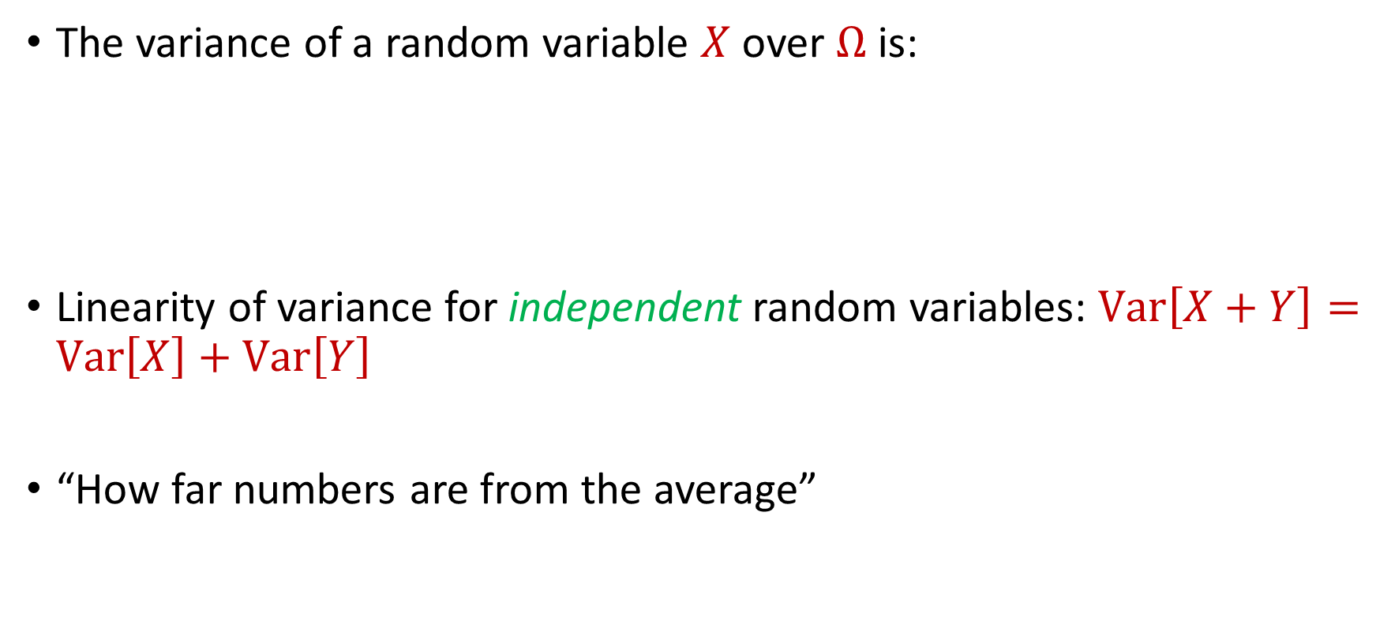
Variance
The variance of a random variable $X$ over $Ω$ is:
Linearity of variance for independent random variables: $Var\left[X+Y\right]=Var\left[X\right]+Var\left[Y\right]$
“How far numbers are from the average”
$$Var\left[X\right]=E\left[X^{2}\right]−{\left(E\left[X\right]\right)}^{2}$$

Slide 55

Variance
Suppose $X$ takes the value $1$ with probability $\frac{1}{2}$ and takes the value $−1$ with probability $\frac{1}{2}$
What is $E\left[X\right]$?
What is $Var\left[X\right]$?

Slide 56

Variance
Suppose $Y$ takes the value $100$ with probability $\frac{1}{2}$ and takes the value $−100$ with probability $\frac{1}{2}$
What is $E\left[Y\right]$?
What is $Var\left[Y\right]$?

Slide 57


Chebyshev’s Inequality
Let $X$ be a random variable with expected value $μ≔E[X]$ and variance $σ^{2}≔Var\left[X\right]$
“What is the probability a random variable is far away from its average?”
$$Pr\left[\left|X−μ\right|≥kσ\right]≤\frac{1}{k^{2}}$$

